Slide 1

march 2023
R workshop
Statistical Software in Public Policy Workshop Series
Alfonso Rojas-Álvarez, Ph.D.
LBJ School of Public Affairs, The University of Texas at Austin

Slide 2
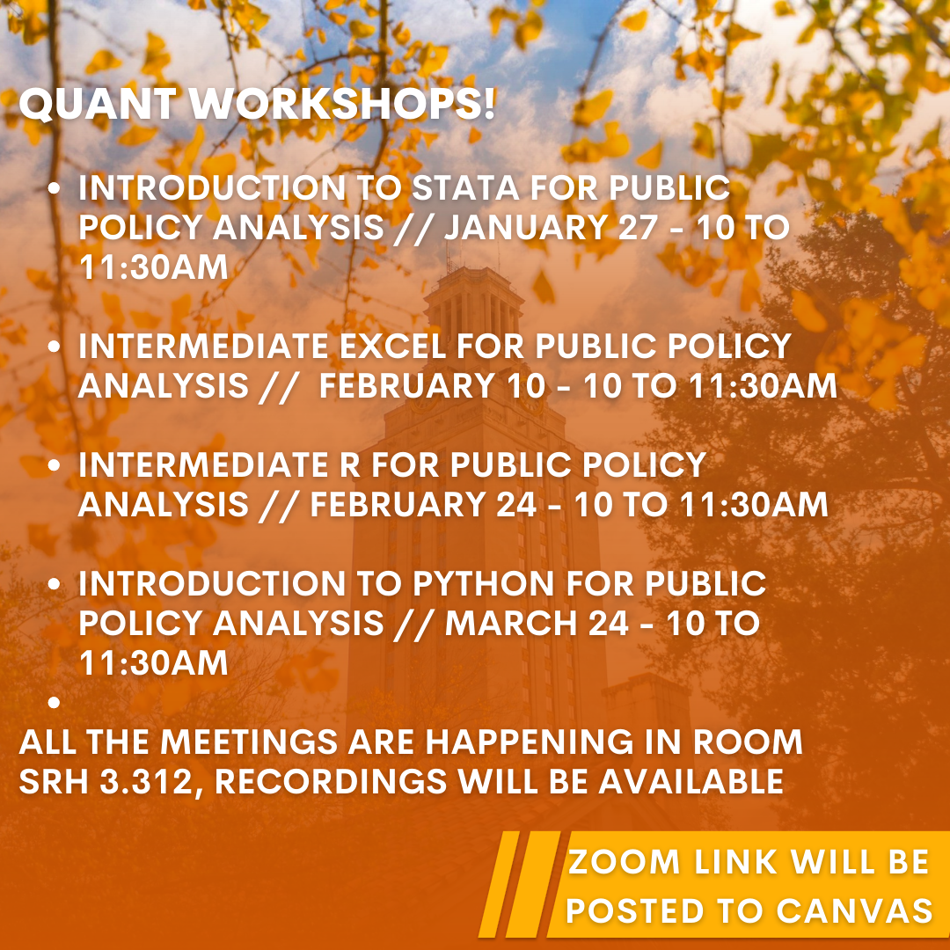
Welcome!
Third of four statistical software workshops in the Spring
Contact: arojas@austin.utexas.edu
(512-552-9860)
Say the class/subject upfront!

Slide 3
About these workshops
Workshops are à la carte; come to any you choose based on your needs.
There is no evaluation, or required participation.
The labs will usually build upon the content of the intro session.
We assume no previous exposure to the software.
We won’t be going over installation of the software.
1 hour of lecture and 10-15 minutes of Q&A and troubleshooting
Feel free to ask questions whenever!
Office Hours for technical, software or installation assistance (or anything else):
Monday 10-11:30am; Thursday 2-3:30pm, in SRH 3.264.

Slide 4
Introduction R in Public Policy
Contents for today’s workshop:
What is R
First steps on using R – sample data set
R Markdown
Data Cleaning
Models
Other Applications
Contents at: https://github.com/LBJ-SoftwareWorkshops/r_workshop

Slide 5
Q&A
Office Hours for technical, software or installation assistance (or anything else):
Monday 10-11:30am; Thursday 2-3:30pm, in SRH 3.264.
Contact: arojas@austin.utexas.edu | (512-552-9860)
Say the class/subject upfront!

